Slide 1
Multilayer meta-matching: translating phenotypic prediction models from multiple datasets to small data Author：Pansheng Chen, Lijun An, Naren Wulan, et al. bioRxiv, 2023. DOI: https://doi.org/10.1101/2023.12.05.569848
Yifei Zhang
Feb 2nd 2024

Slide 2

Abstract
Background: Resting-state functional connectivity (RSFC) is used for predicting phenotypic traits. Large datasets enhance prediction accuracy; however, small-scale datasets are crucial for certain studies.

Slide 3
Abstract
Importance and Purpose: This study underscores the improvement of small dataset phenotype predictions using the proposed "meta-matching" methods.
Questions and Hypotheses: The research investigates if "meta-matching" variants can better predict phenotypes in small datasets from multiple large sources. It hypothesizes that "multilayer meta-matching" outperforms traditional kernel ridge regression (KRR) and transfer learning, especially with very small samples.

Slide 4
Introduction
Meta-Matching: A novel approach to apply large dataset models to enhance predictions in smaller datasets, leveraging inter-phenotype correlations.
Innovation Points: Compared to the previous use of the UKB as a single dataset, this time we applied five datasets of varying sizes to train meta-models for improved generalization effects.
Challenge: A key challenge involves handling imbalances in dataset sizes and the diversity of phenotypes across datasets complicates training a unified DNN for all phenotype predictions.

Slide 5
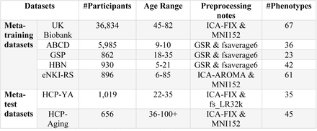
Method----Dataset
Meta-training datasets: UKB, ABCD, GSP, HBN, eNKI-RS
Meta-test datasets: HCP-YA, HCP-Aging
Figure 1.

Slide 6
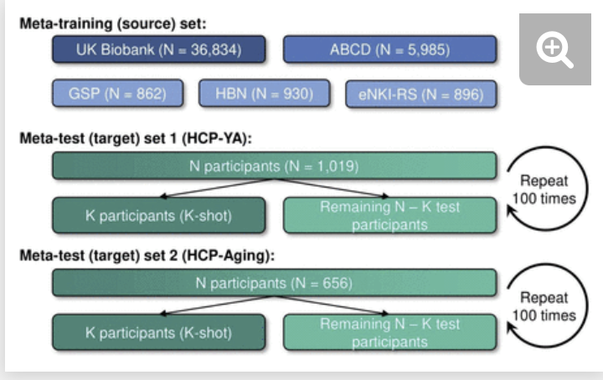
Method----Data split
Meta-training: For each dataset in the training set, we randomly split the data into 80% for training and 20% for validation to train and test hyperparameters for phenotype prediction. (base-learners)
Meta-testing : We train a meta-learner to predict phenotypes from observed phenotypes in each meta-test dataset using a subset of participants (K-shot learning), then assess prediction accuracy on the remaining participants using Pearson‘s correlation and COD.(Where K = 10, 20, 50, 100, 200) (meta-learners)
Figure 2.

Slide 7
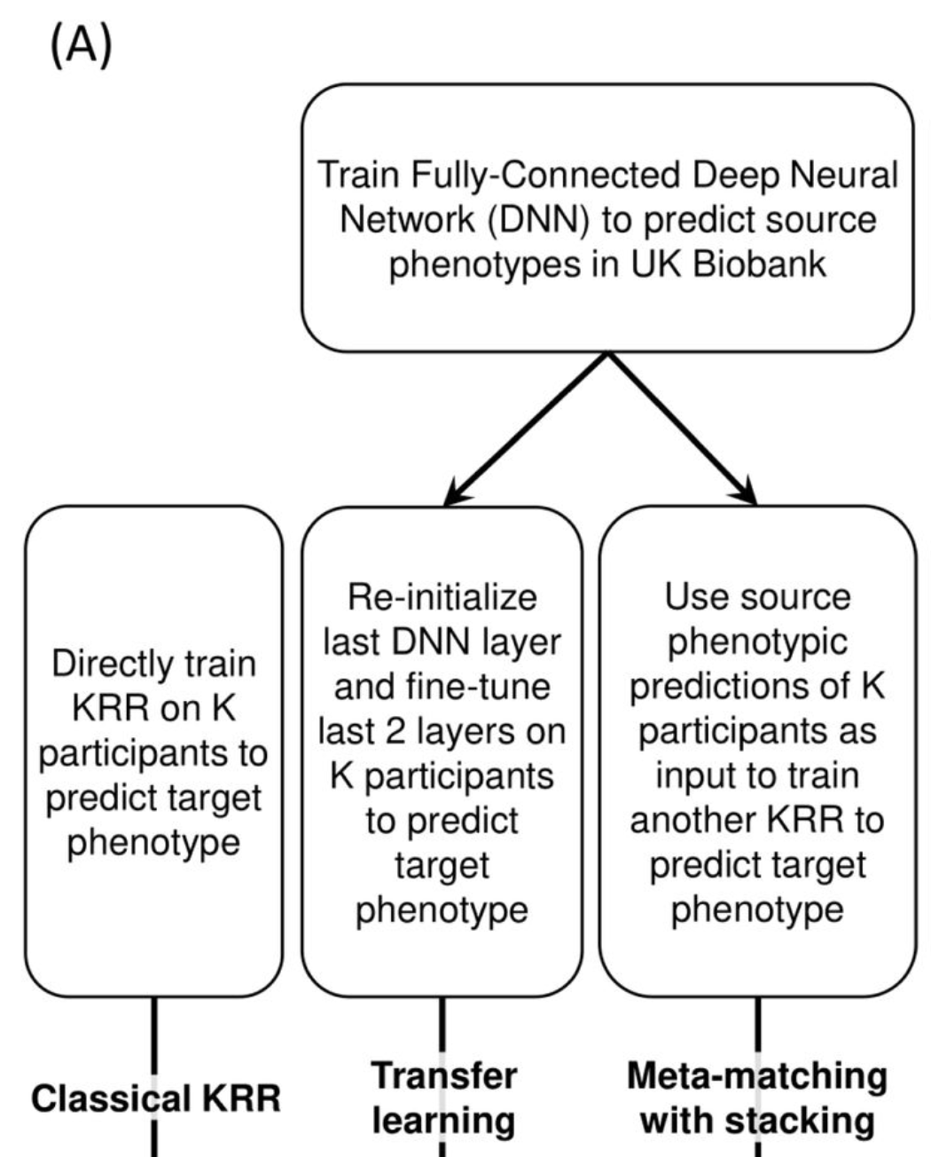
Method---Prediction(3 base)
Classical KRR: Directly train KRR on K participants to predict target phenotype.
Transfer Learning: Applying DNN to predict source phenotypes. Change the last 2 layer of the DNN based on the K participants to predict target phenotype.
Meta-matching with stacking: Using source phenotypes of K participants as input to train KRR.
Figure 3.

Slide 8
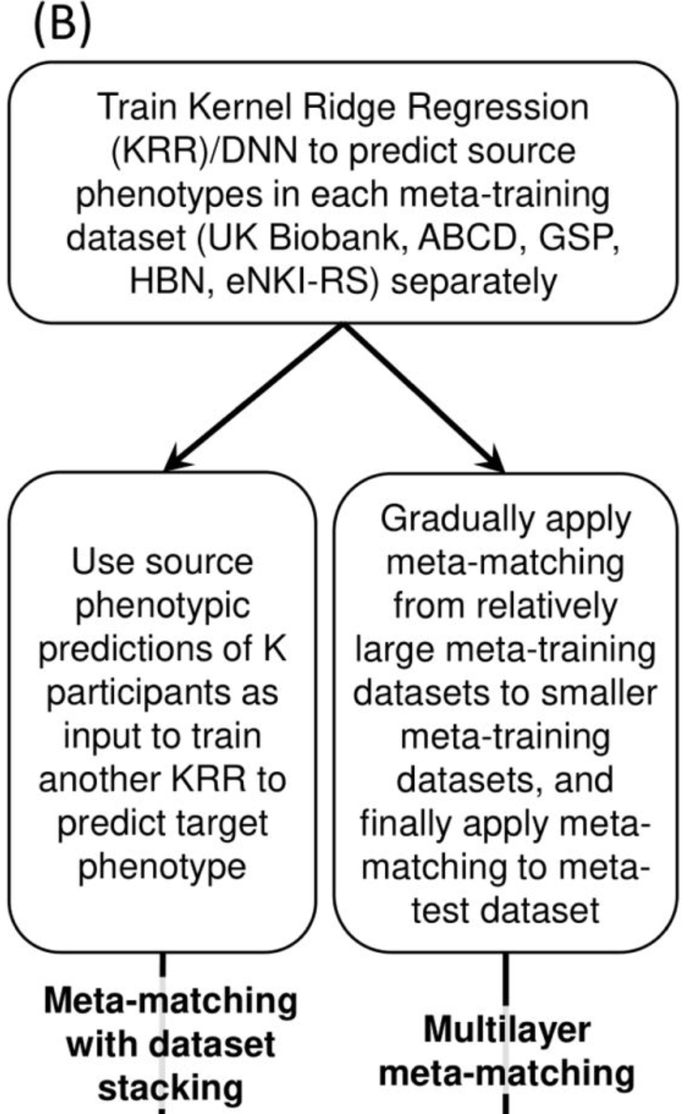
Method---Prediction(2 novel)
Meta-matching with dataset stacking: Train the KRR/DNN separately in 5 dataset. DNN for UKB, KRR for the 5 dataset
Multilayer meta matching: Train the KRR/DNN separately in 5 dataset.
Figure 4.

Slide 9
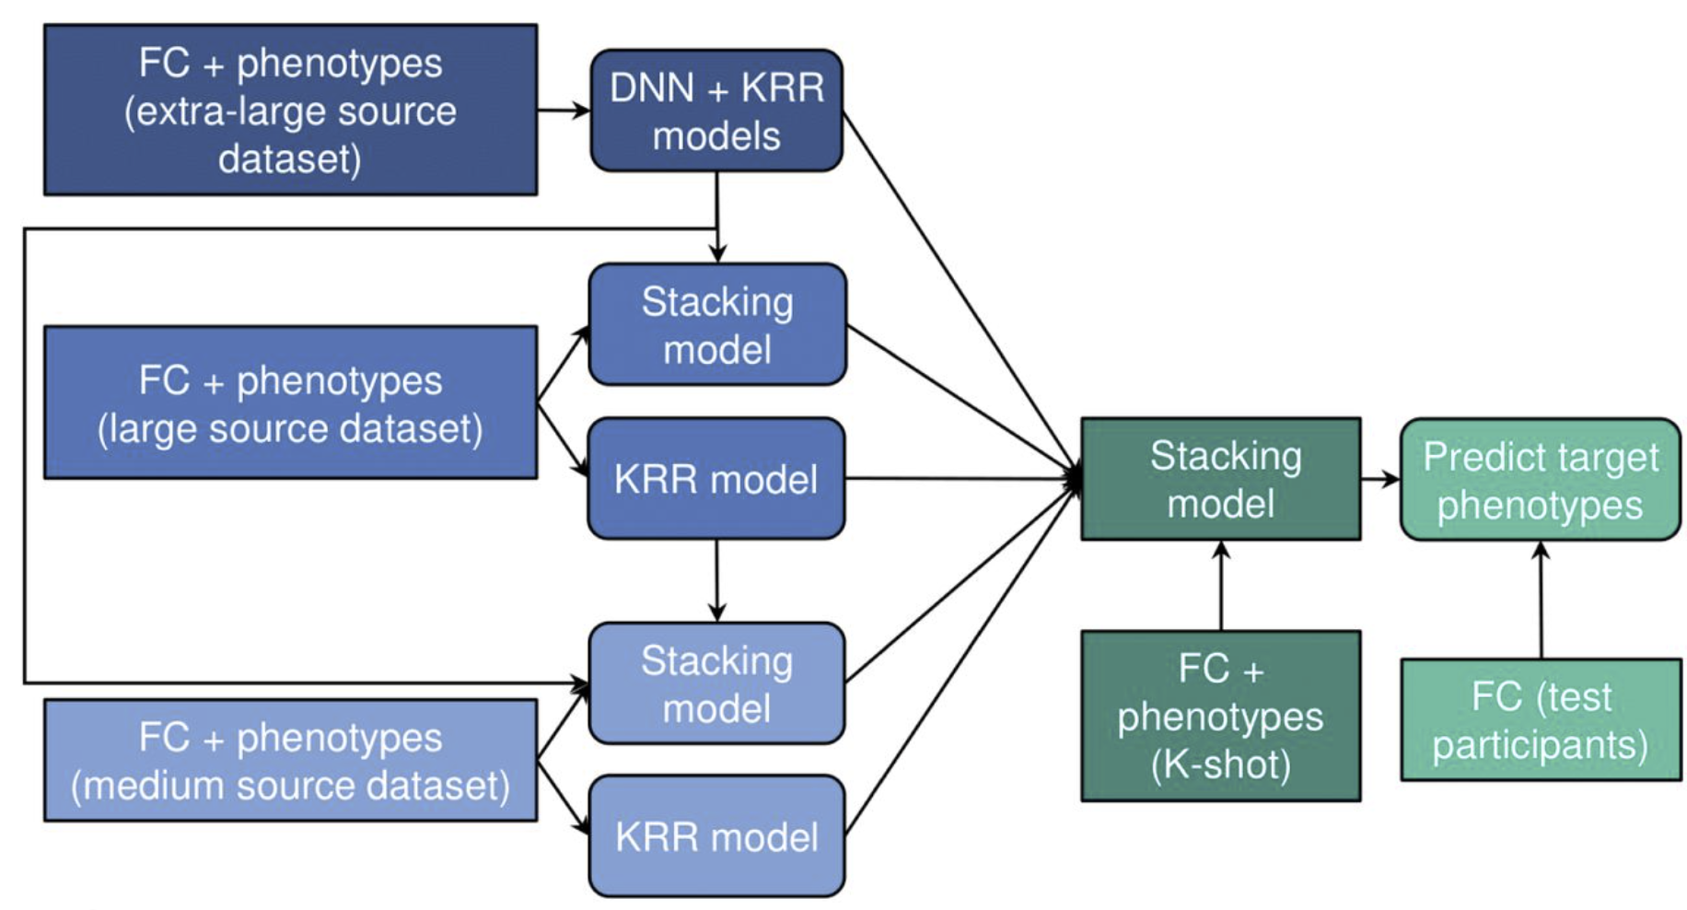
Method---Prediction(2 novel)
Figure 5.
Multi-layer meta-matching gradually applied meta-matching with stacking from relatively large source datasets (e.g., UK Biobank) to smaller datasets (e.g., HCP), to generate additional features for a final round of stacking using the K participants from the meta-test dataset.

Slide 10
Method---Haufe transform
Haufe transform:
Training a linear model (SVM or LDA)
Getting a vector of weights
Calculating the covariance matrix of the features of training data
Multiplying the original weight by the covariance matrix
The feature importance value for each RSFC edge.
Pseudo ground truth feature importance

Slide 11
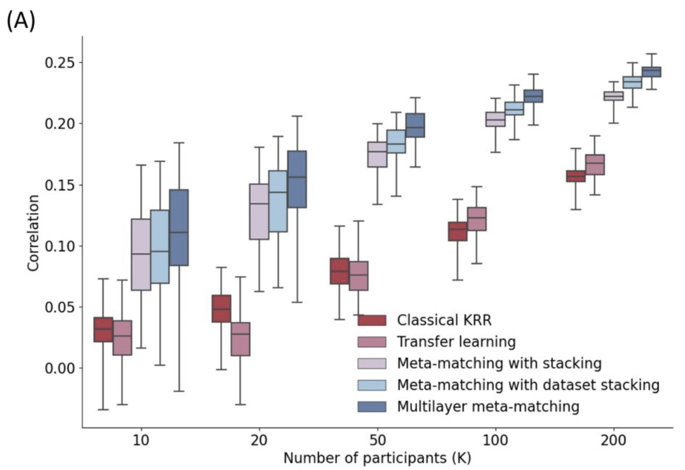
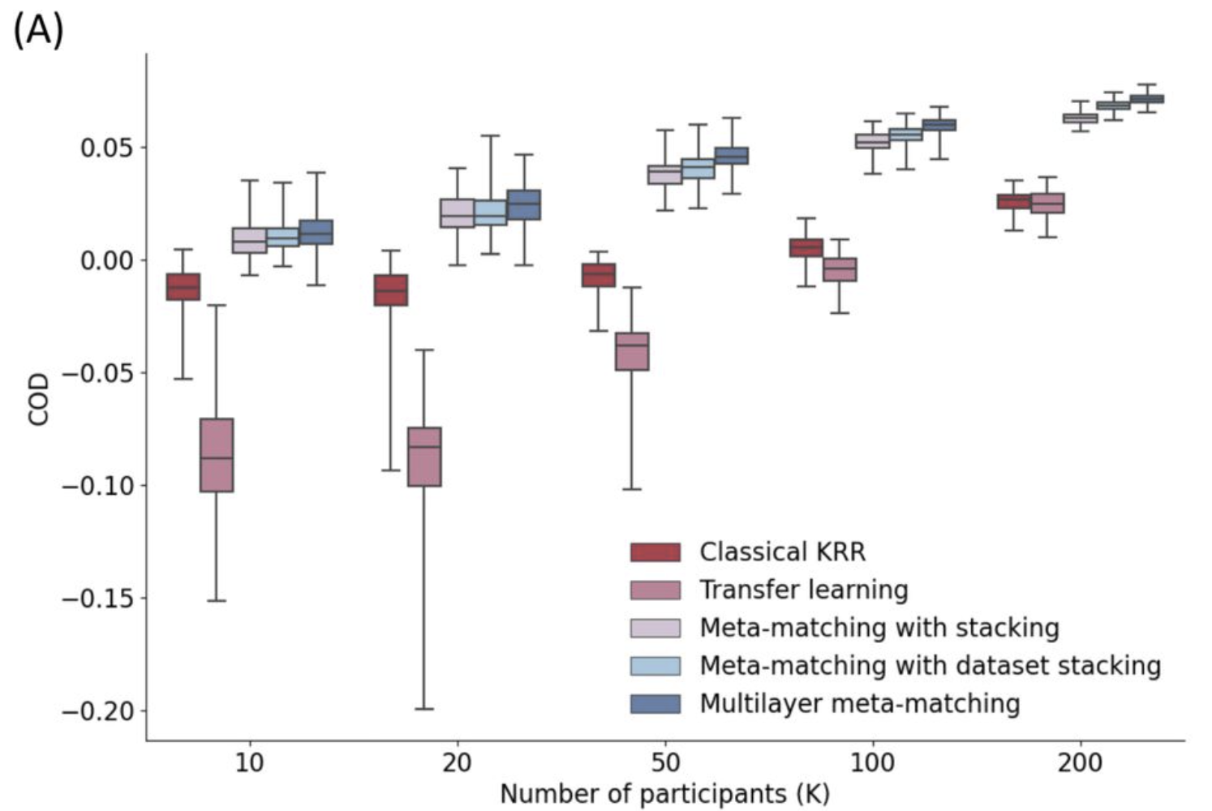
Result----HCP-YA
Figure 6.
Figure 7.
Phenotypic prediction performance in terms of Pearson’s correlation (averaged across 35 meta-test phenotypes) in the HCP-YA dataset.
Phenotypic prediction performance in terms of COD (averaged across 35 meta-test phenotypes) in the HCP-YA meta-test set.

Slide 12
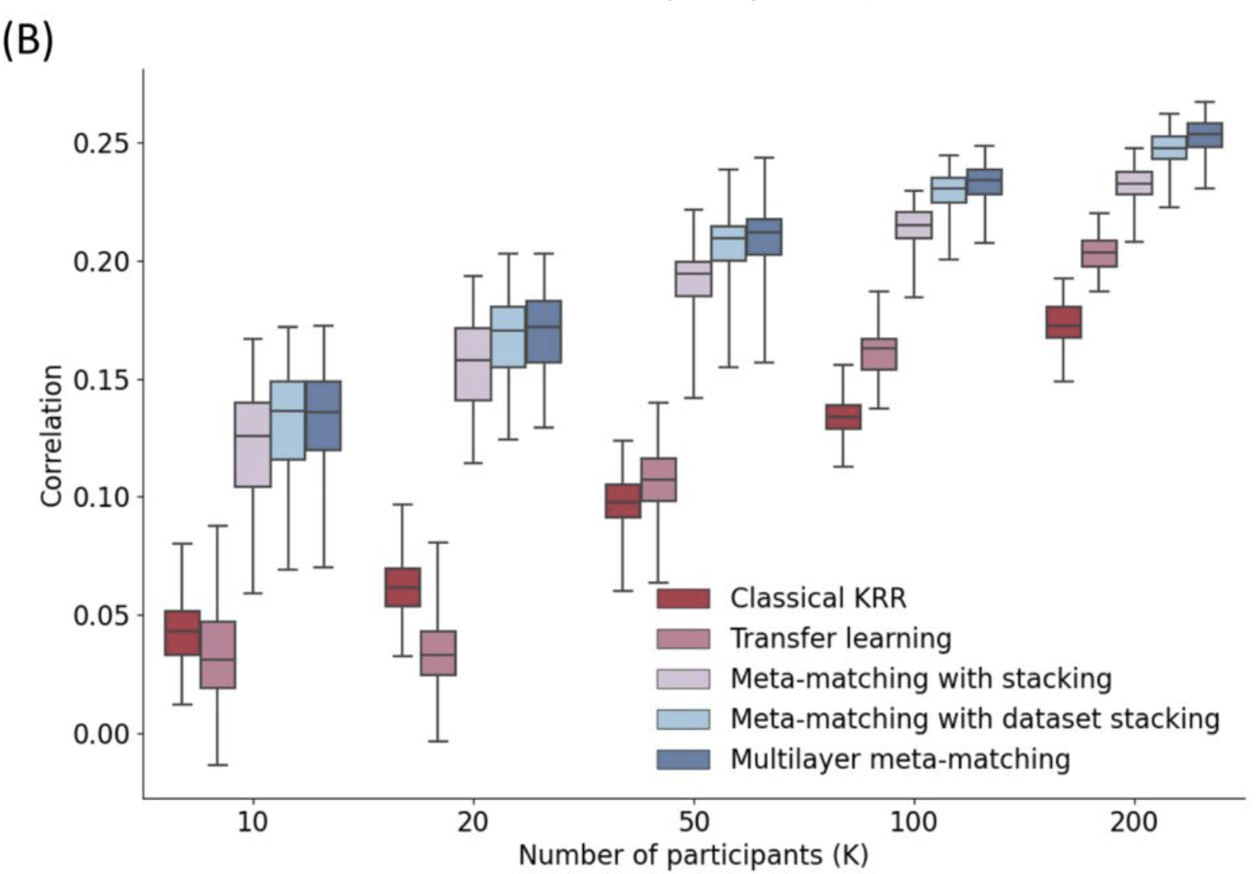
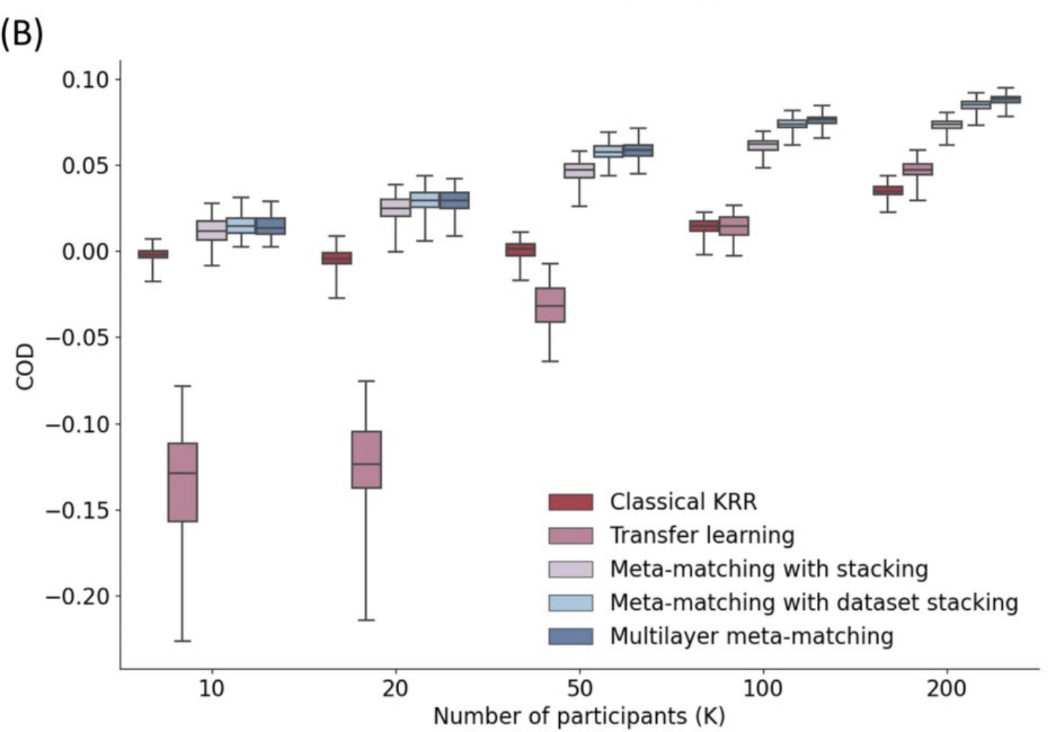
Result----HCP-Aging
Figure 8.
Figure 9.
Phenotypic prediction performance in terms of Pearson’s correlation (averaged across 35 meta-test phenotypes) in the HCP-Aging dataset.
Phenotypic prediction performance in terms of COD (averaged across 35 meta-test phenotypes) in the HCP-Aging meta-test set.

Slide 13
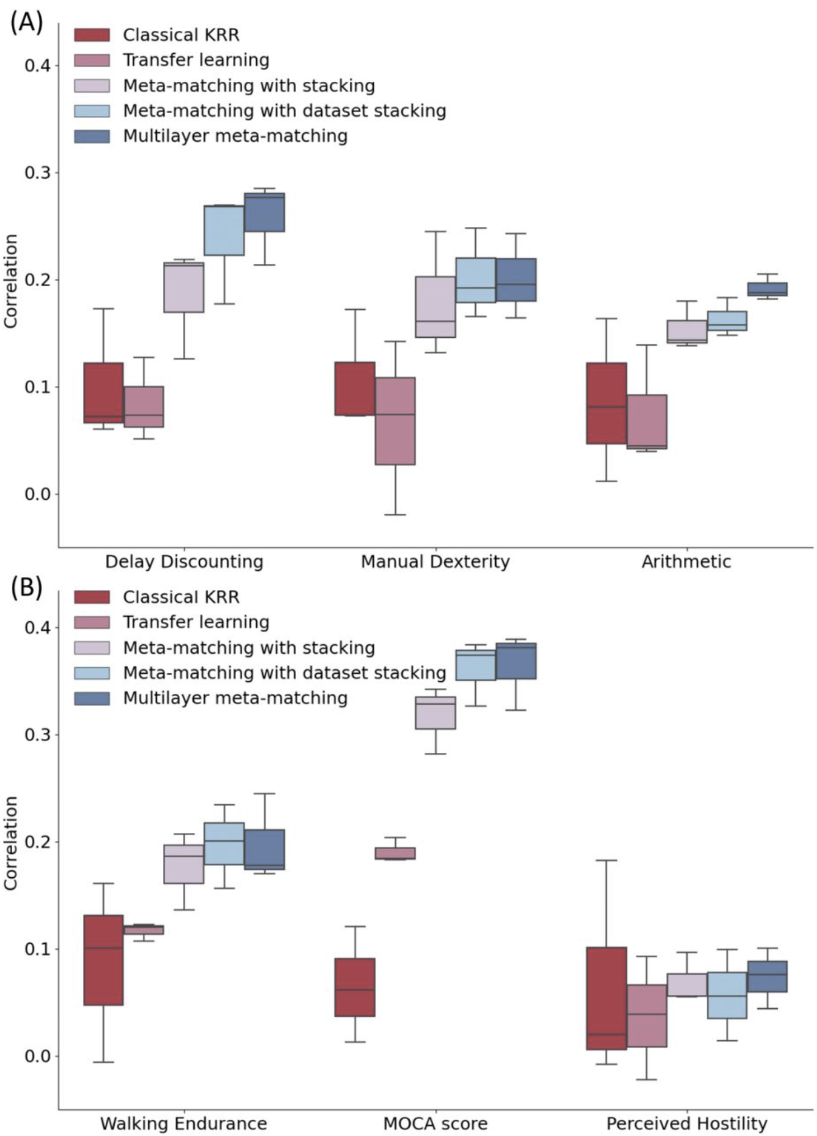
Result----sample phenotypes
Examples of phenotypic prediction performance in the (A) HCP-YA and (B) HCP-Aging datasets in the case of 100-shot learning (K = 100).
Fig 10.

Slide 14
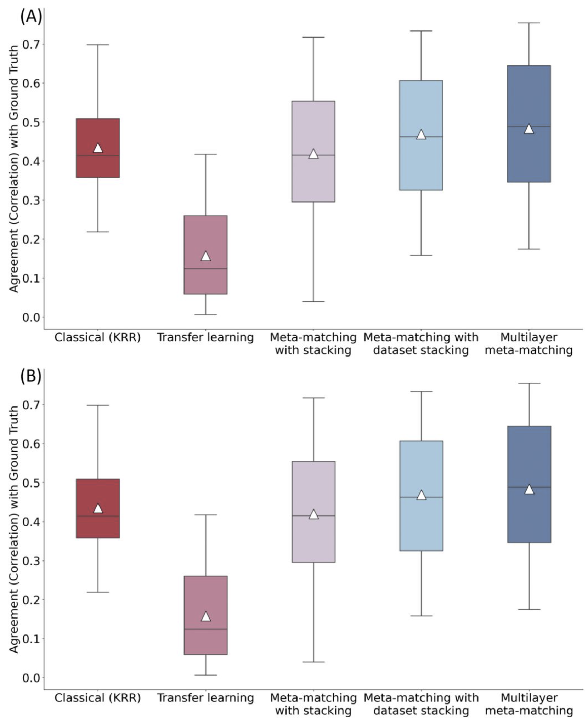
Result----importance of Haufe transform
Agreement (correlation) of feature importance values with pseudo ground truth in the (A) HCP-YA and (B) HCP-Aging datasets.
Fig 11.

Slide 15
Discussion and Conclusion
We developed two meta-matching algorithms that outperform standard KRR and transfer learning in predicting phenotypes from small datasets.
Multilayer meta-matching showed the best performance, closely aligning feature importance with established pseudo ground truth.
Transfer learning faced difficulties with small sample sizes but improved with more participants, highlighting the challenge of parameter finetuning.
While using multiple source datasets improved predictions slightly, the large size of UK Biobank dominated the benefits.
Future extensions could apply meta-matching to various imaging modalities and enhance generalization for psychiatric datasets.

Slide 16
Navy Blue Slide with UNC Logo

